Slide 1

Presentation Against Gun Control
Ryan Lee
Data 101

Slide 2
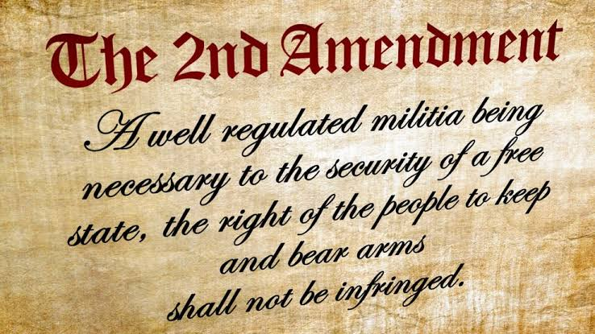
Second Amendment
The statement refers to the Second Amendment to the United States Constitution, which guarantees the right of Americans to keep and bear arms. This amendment was added to the Constitution in 1791 and has been the subject of much debate and controversy over the years. While the amendment ensures that individuals have the right to own firearms, there are also laws and regulations in place to regulate this right and ensure public safety.
Image Source : https://www.historyonthenet.com/second-amendment-to-the-united-states-constitution

Slide 3
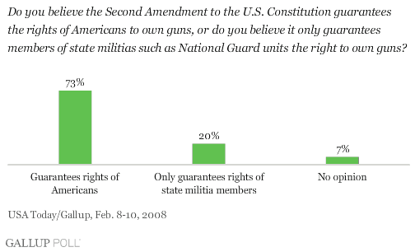
Survey About Second Amendment
73% of people says Second Amendment guarantees American rights.
This suggests that a significant majority of Americans believe in the importance of this constitutional provision and see it as a crucial element of their personal and collective freedom.

Slide 4
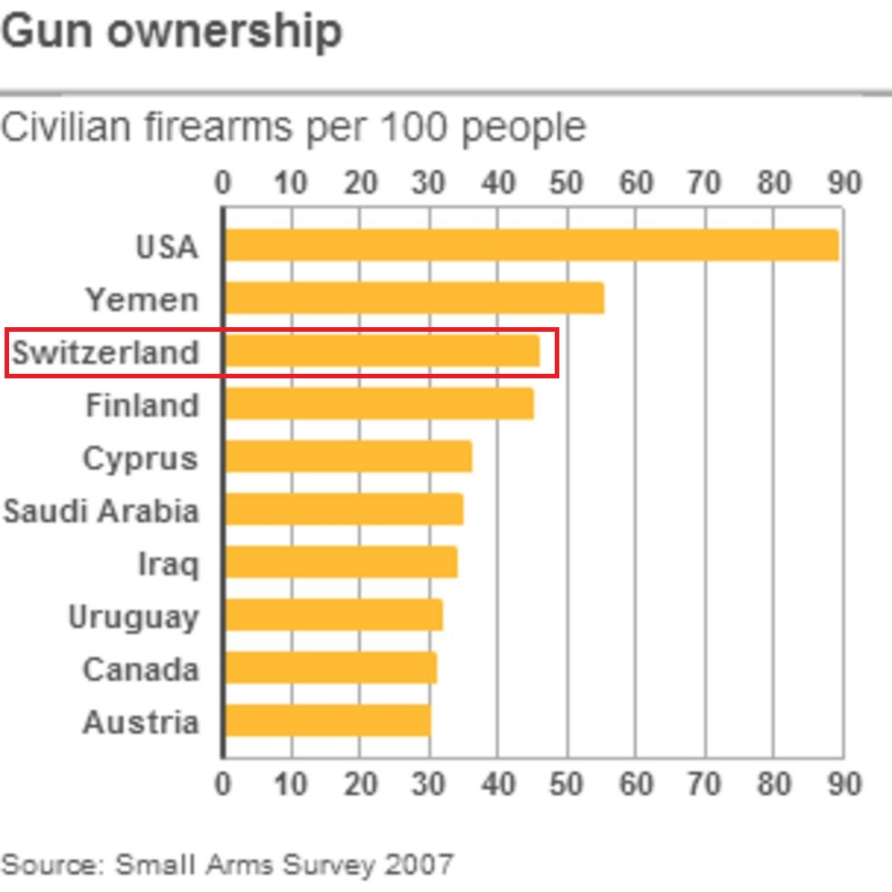
Effectiveness of Gun Control
Switzerland is one of the countries where gun ownership is relatively free. On the other hand, Mexico is a country with very strict gun control. Looking at the table below, you can see that Switzerland is high on the list, but Mexico doesn't even exist.

Slide 5
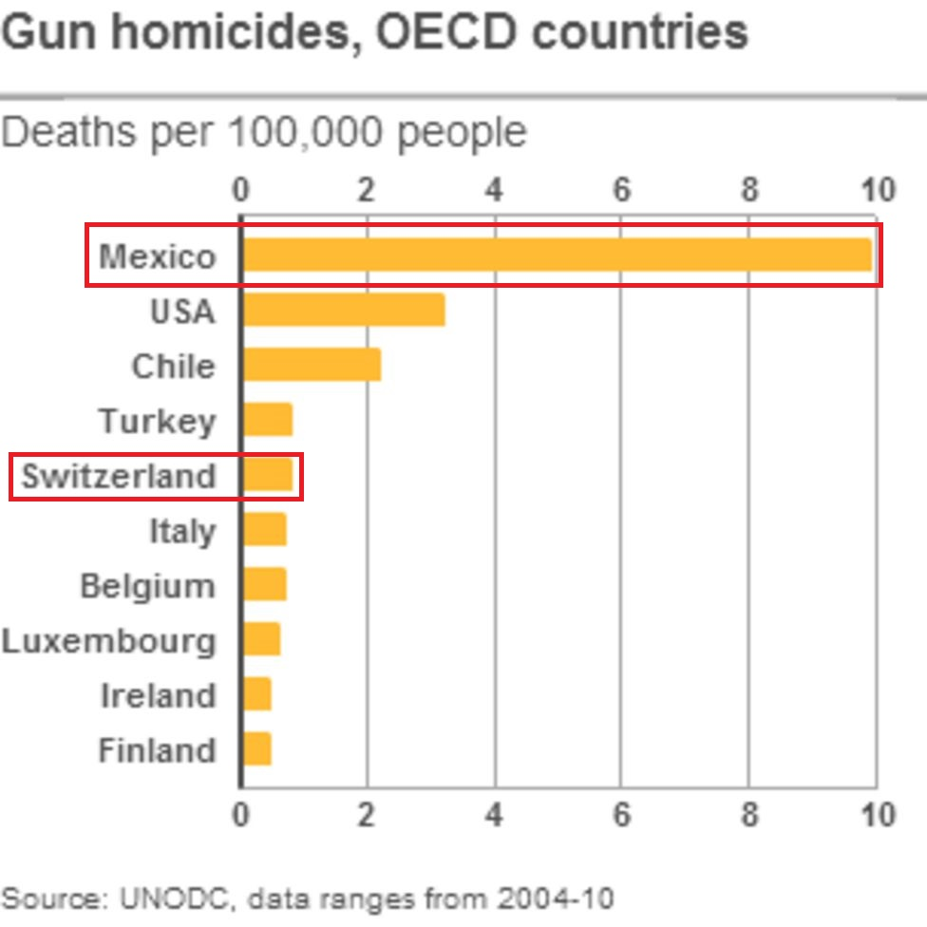
Effectiveness of Gun Control (Continue)
Nonetheless, Mexico has one of the highest gun homicide rates in the world. If you look at the table next to this, you can see that Mexico has more than 10 times more gun homicides than Switzerland, despite strong gun laws.
If gun control cannot prevent gun homicides, it would be meaningless.

Slide 6

Possibility of Black Market
A black market is an economic activity that takes place outside government-sanctioned channels.
ILLEGAL
Image Source: https://blackmarkethummus.ca/

Slide 7
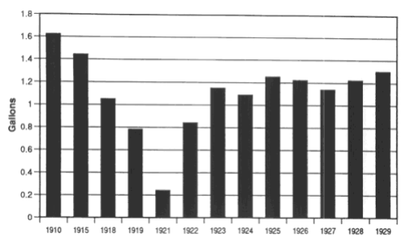
Example of Alcohol Prohibition
Per Capita Consumption of Alcoholic Beverages
Alcohol prohibition was in effect from 1920 to 1933. In practice, however, alcohol consumption remained high except immediately after the prohibition was enforced.
Black Market.
Source: Clark Warburton, The Economic Results of Prohibition
(New York: Columbia University Press, 1932), pp. 23–26, 72.

Slide 8
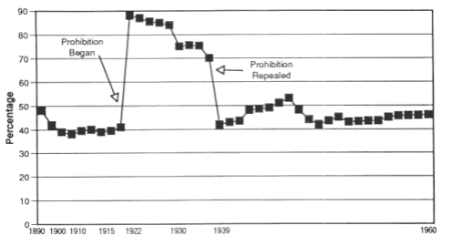
Example of Alcohol Prohibition
Total Expenditure on Distilled Spirts as a Percentage of Total Alcohol Sales
You can see that sales of alcohol increased during Prohibition. This sudden gun control could create an illegal market.
Source: Clark Warburton, The Economic Result of Prohibition (New York: Columbia University Press, 1932),
pp. 114–15; and Licensed Beverage Industry, Facts about the Licensed Beverage Industry (New York: LBI, 1961), pp. 54–55.

Slide 9
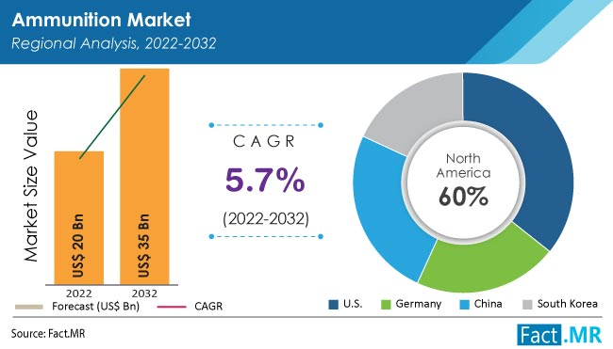
Economic View
The gun industry now makes up a $20 trillion market. In addition, continuous growth is expected in the future. But sudden gun control threatens to dampen a thriving industry.
Source: https://www.factmr.com/report/4535/ammunition-market

Slide 10
Questions
1. Is your data to be trusted?
Yes. I tried to find my data from trustful sources and avoid biased data.
2. Is there cherry-picking present? Is there bias, like partisan bias - whose web site are you quoting, whose publication?
For the “effectiveness of gun control” part, rate of gun ownership and rate of gun homicides are both high for United States. But I intentionally ignored that part and focused on Switzerland and Mexico. There was no bias for the data because I excluded it.
3. Is data statistically significant (sample size?)
For “Survey About Second Amendment”, there is Gallup survey screenshot. Gallup usually have 1,000~1,500 participants for each survey, so I thought this data is somewhat reliable.
4. May we be fooled by data? - for example it is possible that hidden variables are ignored?
Yes, there could be some hidden factors for the data. For example, in the “Effectiveness of Gun Control” part, there could be other factors that cause large number of gun homicides in Mexico regardless gun control.

